Slide 1
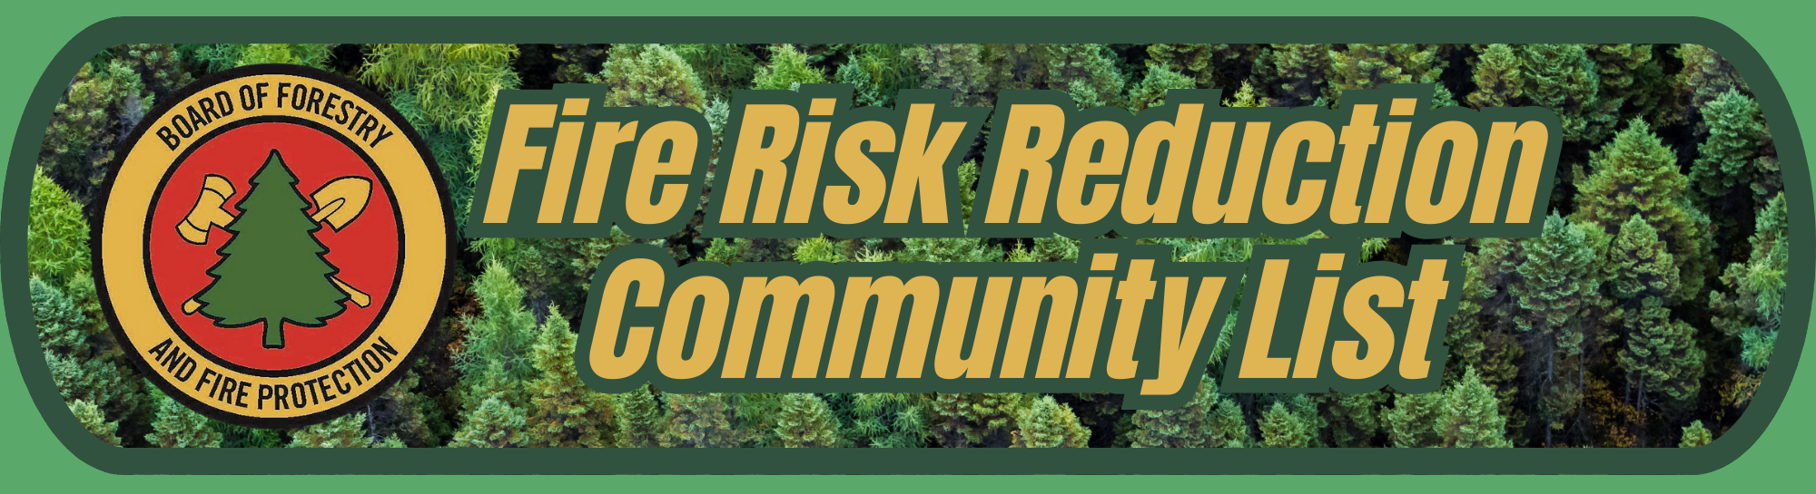
2024 FRRCL Survey Results
Resource Protection Committee November 5, 2024

Slide 2
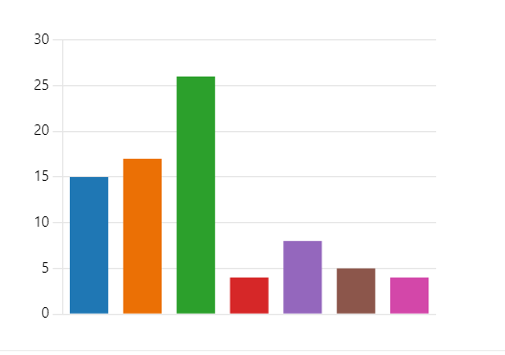
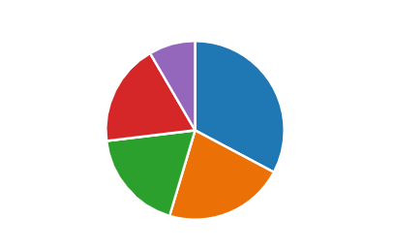
Background and Results
The 2024 Fire Risk Reduction Community List Survey opened October 1st and closed October 15th. The survey was sent to all 2022 and 2024 applicants and posted on the Board’s website. 60 responses were recorded.
Survey Demographics:
29% of respondents have never applied for the FRRCL but were interested in applying in the future.
50% of respondents were Cities or Counties, 50% Special Districts, 0% Tribes.
97% of respondents who had applied in 2022 and/or 2024 indicated their agency planned on re-applying.
Public Awareness:
Other
How did you hear about FRRCL?
How should the Board increase public awareness?
8%
18%
33%
Email Reminders
Brochures for Local Agencies
Homeowners/ Community
Department of Insurance
Colleagues/other jurisdictions
CAL FIRE
Board of Forestry
Legislation
Other
Webinars
Brochures for
Homeowners
18%
22%
Learning about the program through colleagues and other jurisdictions was the most poplar answer (43%) .
Informational Brochures for local agencies and homeowners were most popular.
Notes:
We can conservatively expect to receive at least 70 applicants for 2026, however real number may be greater
The BOF Land Use Team partnered with Deputy Chief Helen Lopez of CAL FIRE’s Tribal Affairs program and Natalie Burk from Grants to give a presentation geared towards Tribal Nations on October 22nd.

Slide 3
Results Continued
36% of Respondents reported no benefit yet.
“Other” Responses:
"My agency may have received benefits but unaware of any significant benefits for residents regarding insurance or obtaining grants.“
"Helps demonstrate to the community that fire prevention is a priority to my agency.“
"Unsure if we have benefited…did receive a CAL FIRE Wildfire Prevention grant but are unaware if being an applicant was a benefit in the process."
Important Note: 2024 FRRCL Applicants would receive priority for 2025/2026 Grants
Notes:
Increase awareness of how FRRCL intersects with Grant timelines.

Slide 4
Results Continued
Are there any other important objectives or goals not previously mentioned that influenced your agency's decision to apply for the 2024 FRRCL?
“Biggest goal is to reduce fire insurance rates for residents or stop them from being dropped by carriers…we want to help them as much as possible before the next fire strikes.”
“Opportunity to lead by example for the community, hopefully spurring action at the parcel level. Demonstrate the benefits to agency executives and elected officials in funding fire planning efforts.”
“…we applied for inclusion on the list to demonstrate to CAL FIRE that we take wildfire protection and suppression seriously.”
“We take pride in being a role model community to our neighbors and being recognized for the hard work of our community to prepare for and live safely with wildfire. This program serves as an incentive to achieve best practices for planning for wildfire.”
Grants
8.68
Insurance
8.75
Recognition
8.14
Notes:
All three objectives are very important to our applicants.

Slide 5
Takeaways for Procedural Improvements:
    More Reminders and Outreach:
      Utilize Board’s mailing list as well as list of previous FRRCL applicants to end out email reminders prior to next application period.
      Utilize relationships with stakeholders to help disseminate open application period.
      Outreach to FirewiseUSA communities to disseminate information
    Create Brochures for Website:
      Cities and Counties
      Special Districts and Tribes
      Homeowners
    Clarify Application Criteria Requirements:
      Examples of application and supporting docs.
      Add webinars that cover criteria specifically.
      Update FAQ’s.
    Clarify Application Submission Requirements:
      Add free Box account link to webpage
      Increased communication on application requirements.
“We were lucky to get a notification of the application for the 2022 list from our local Fire Safe Council or we would have missed the application period. Reaching out to Cal Fire and local Fire Safe Councils would be a great route to local fire departments and special districts.”
“For new applicants, a workshop that reviewed the items in the application would be helpful.”
“…it would be helpful for a county like ours, with a lot of work to do to become eligible, to get some guidance, resources and best practices examples that might make the process more attainable.
“Box was a little tricky at first because it took a while for me to figure out how to create a free account. A very minor improvement might be to have clear instructions on how to create a free Box account for agencies that don't use Box.”
Notes:
\

Slide 6
Feedback for potential Board Discussion:
Are there any other fire planning actions that you would like to see included as future application criteria?
“...we have fuel management standards that adhere to the State minimum requirements while also considering the ecological health of different habitat types. It's not necessary, but including a fuel management standards would be something to consider.”
“In addition to planning, recognize implementation of planning efforts such as completed vegetation management projects, appraisal/estimate of property owners hardening their structures, meeting defensible space requirements (or local agency can document they are inspecting a certain % of their residents each year, pre-attack mapping (PODS), etc.”
“No, I believe the list comprehensively covers the important non-subjective fire planning actions that agencies can take.”
“Ask about what adopted HIZ process is being used, is it standardized across an acceptable platform or is it specific to the agency needs? Is the application using HMM, HIZ, NFPA, Firewise as the metric?”
“Some form of extra recognition for agencies that are 100% volunteer. Without any paid staff, all efforts to maximize community safety and resiliency require ever more time and effort by overloaded volunteers. This isn't a paid job, this is true dedication.”
“Building capacity in the suppression side of the wildfire reduction efforts many local fire districts get little to no credit for wildland response capabilities due to it not being a primary mission in SRA areas”

Slide 7
Continued:
Other program feedback:
“…would like to participate in an application if CDI requires FRRCL status to receive a mandatory discount from insurance companies. This was not communicated during the last application period, or we would have applied. It is also unreasonable to only accept applications every two years if FRRCL is going to have a financial impact on residents without a FRRCL status.”
“Most local insurers are unaware of FRRCL and have been denying insurance discounts to residents. We have initiate conversation with the Department of Insurance on this issue.”
“I would also love to see a certificate. Our community members are asking for something to send to their insurance carriers about being on the FRRCL. Something similar to the Firewise certificate would be sufficient. For now, I am sending them the FRRCL link to the BOF's website.”
“After being included on the 2024 list and informing our community residents, fire insurance providers seemed oblivious of their requirements to factor FRRCL mitigation work into their rate structure. Several would accept only Firewise certifications. So, it seems informing/educating insurance providers needs to be added to BOF's ways to increase public awareness. Use insurance company's outreach to urge greater awareness and understanding ...”

Slide 8
Thank you to our survey participants!
“We are very honored to be on the list and worked hard on the application, and in our wildfire mitigation efforts. Love working with Cal Fire!”

Slide 9
Questions / Discussion

