Slide 1
Defensible Space & Zone 0 Presentation Larry Williams, VCFD Assistant Fire Marshal (Retired)
California Board of Forestry
and Fire Protection
Zone 0 Advisory Committee
May 12, 2025

Slide 2
Mountain fire
Mountain Fire 2024

Slide 3
Mountain Fire
11/06/24 at 8:51 AM
19,904 – Total acres
243 - Structures destroyed
0 – Deaths
NWS – Potentially Damaging Winds event forecasted.
Wind speeds same as Palisades Fire.
Fire spotted 2.5 miles across an agriculture valley and ignited brush and homes in the Camarillo Area.

Slide 4
Mountain fire - aftermath
Mountain Fire 2024

Slide 5
palisades fire
Palisades Fire 2025

Slide 6
PALISADES Fire
1/07/25 at 10:30 AM
23,448 – Total acres
6,837 - Structures destroyed
9 - Deaths

Slide 7
palisades fire - aftermath
Palisades Fire 2025

Slide 8
Eaton fire
Eaton Fire 2025

Slide 9
Eaton Fire
1/07/25 at 6:18 PM
14,021 – Total acres
9,418 - Structures destroyed
25 - Deaths

Slide 10
Eaton fire - aftermath
Eaton Fire 2025

Slide 11
Prevention efforts
Defensible Space
VCFD’s Fire Hazard Reduction Program is nationally recognized for reducing the risk to homes and businesses
First enacted in 1929 under County Ordinance (30 feet)
Expanded in 1931 to include adjacent parcels within the required clearance zone from structures.

Slide 12
Prevention efforts
Defensible Space
1950 the clearance zone was expanded to 60 feet.
1991 expanded to 100 feet.
Notices sent to about 19,000 properties in April, outlining the minimum vegetation management requirements
Residents have been incredibly supportive: More than 99 percent complete the vegetation management

Slide 13
Brush clearance

Slide 14
Brush clearance

Slide 15
Prevention efforts – zone 0
April 2019 VCFD issued Standard 515 which introduced the 0-5 foot zone around buildings as an ember resistant zone. It also set requirements for vegetation height, width, and spacing in Zones 1 & 2.
As a result of fires statewide since 2019, including the Mountain Fire and the LA Fires, and full-scale testing of exposure fires adjacent to buildings, VCFD issued revised Standard 515:

Slide 16
Prevention efforts – zone 0
Non-Combustible Zone 0 for New Buildings and Additions to Existing Buildings. Effective March 1, 2025, fuels, including combustible materials and vegetation, are prohibited in Zone 0 for all new buildings, additions to existing buildings, installation of new landscape, and refurbishment of existing landscape areas.
Additional Requirements in Zone 0:
Trees. New and existing tree canopies are prohibited within 10 feet of new buildings, including the addition portion to existing buildings.
Exception for Protected Oak Trees. Existing protected oak trees shall be trimmed to provide a minimum 5-foot clearance above the roof and 5 feet to the side of any new building, or the addition portion to an existing building.

Slide 17
Prevention efforts – zone 0
Landscaped roofs are prohibited.
Vegetation on and underneath decks is prohibited.
Other combustible materials underneath any deck, not part of the deck structure itself, shall be removed.
No new window planting boxes shall be attached to the structure.
Artificial or synthetic grass is prohibited within Zone 0.
Vines and climbing plants are not allowed on structures, including decks, patio / shade structures, and any fences within 5 feet of a building.
No Firewood.
All fencing and gates shall be non-combustible.

Slide 18
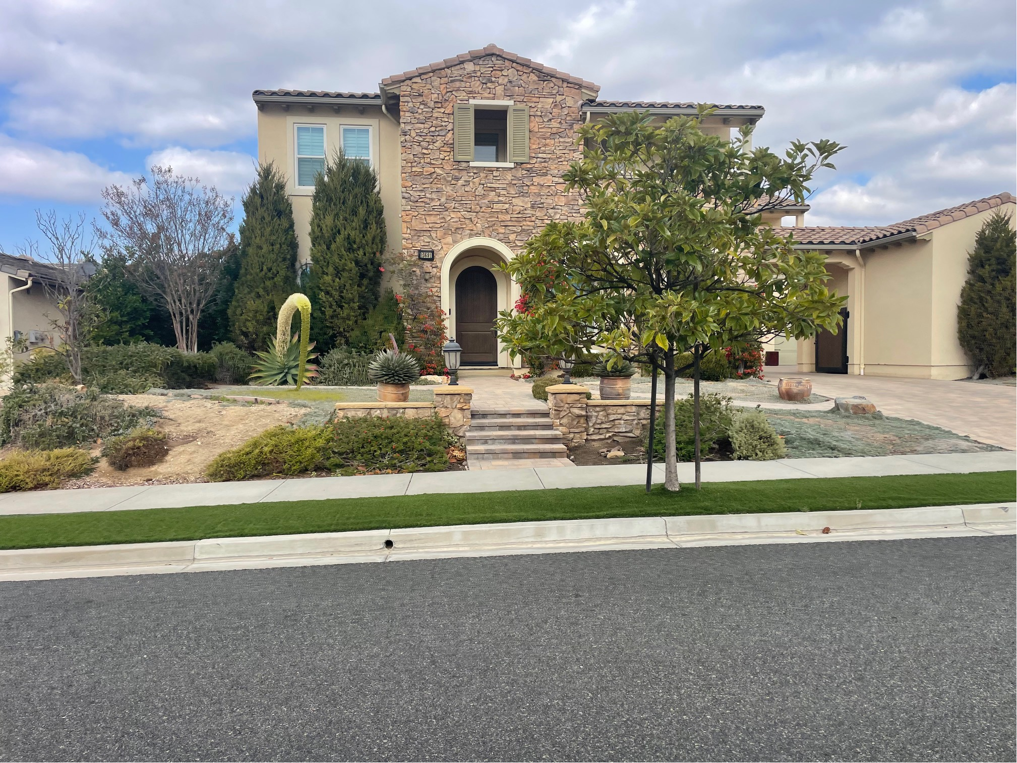
Ornamental landscape - risk

Slide 19
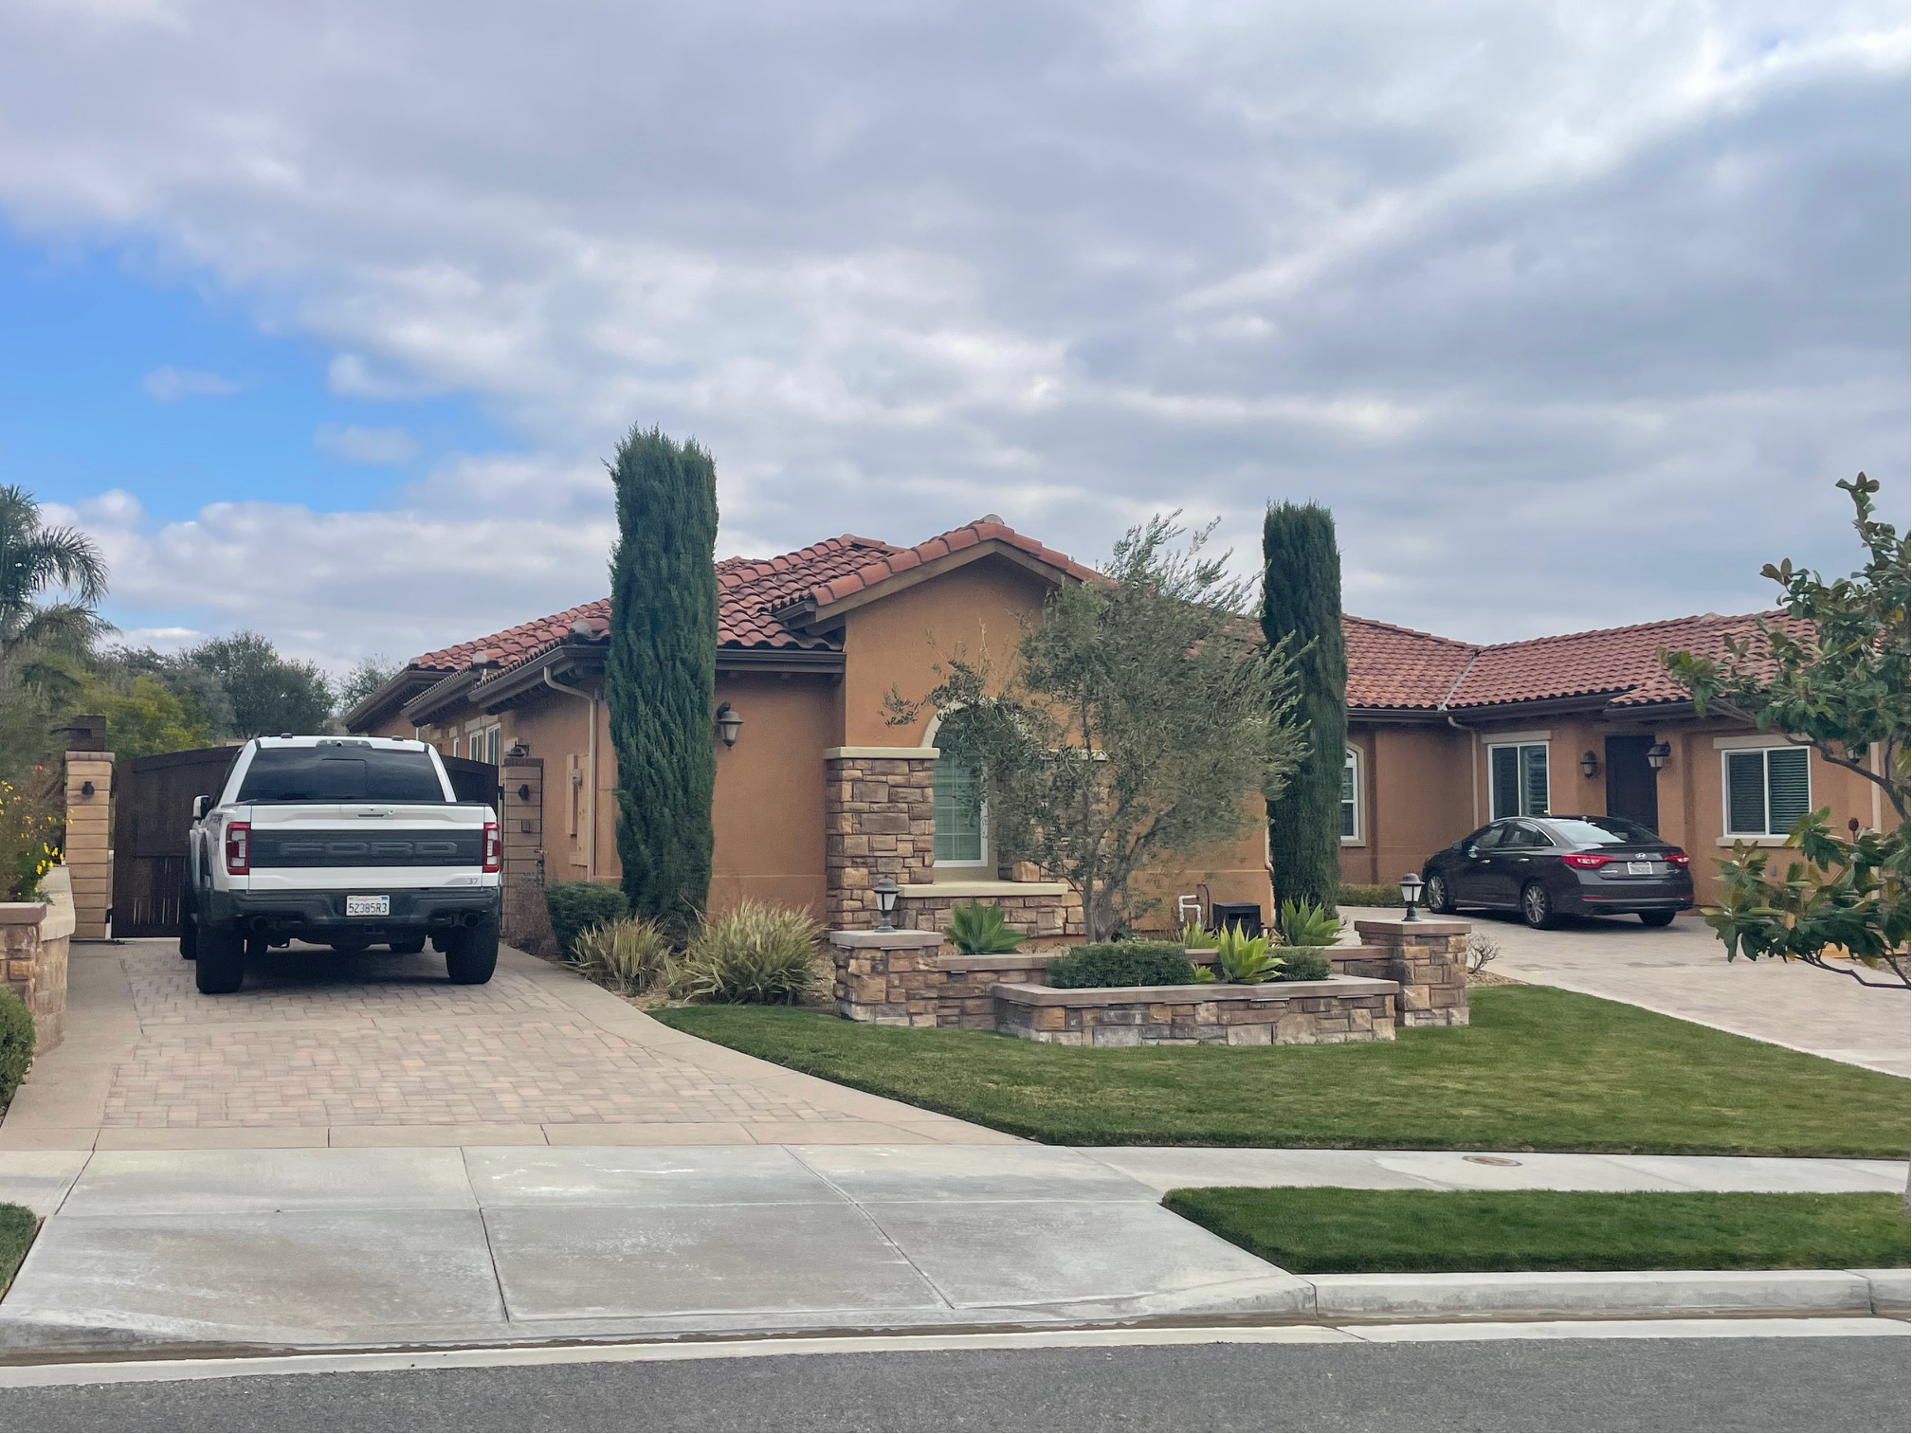
Ornamental landscape - risk

Slide 20
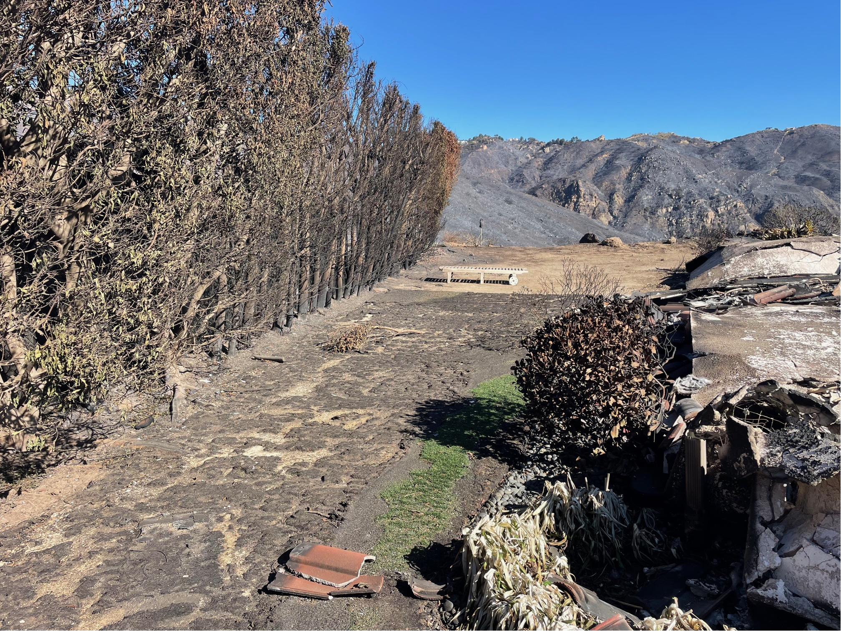
Ornamental landscape - risk

Slide 21
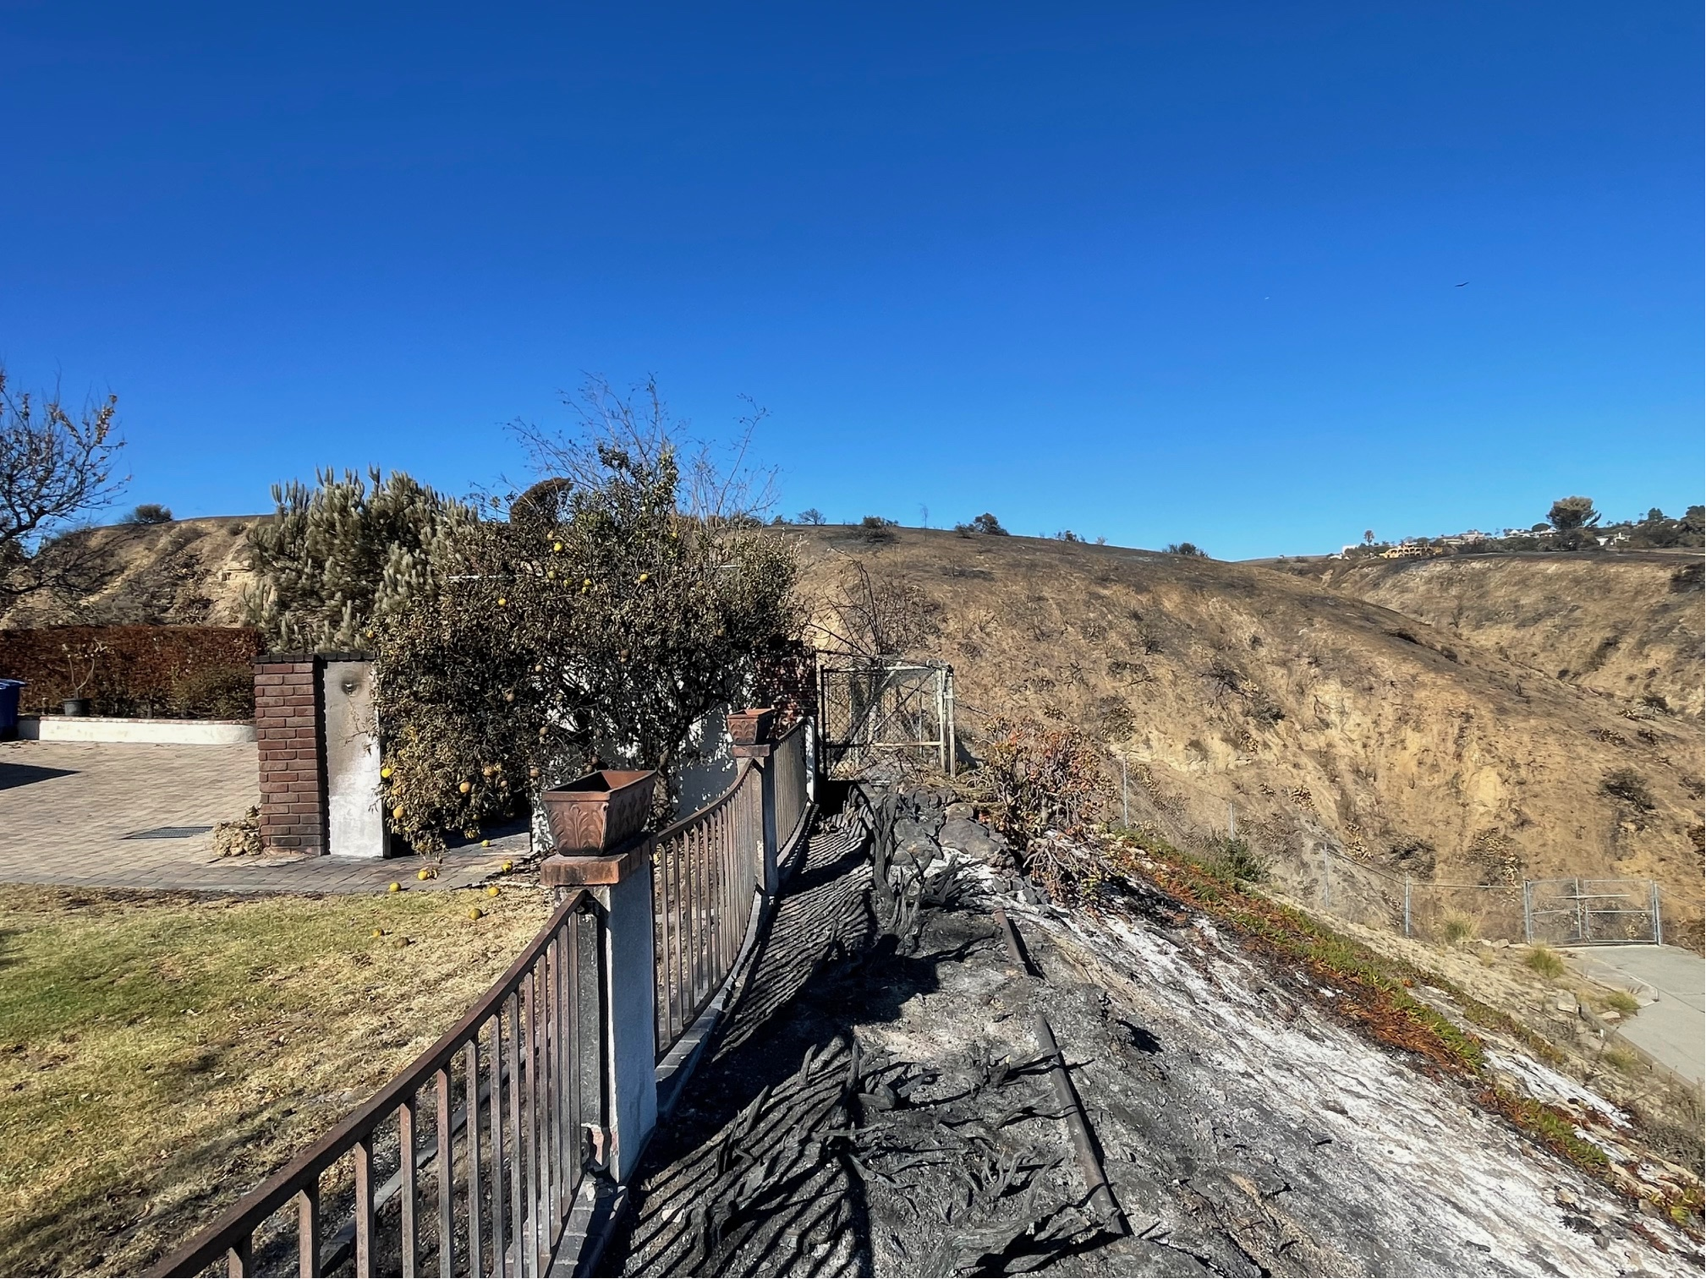
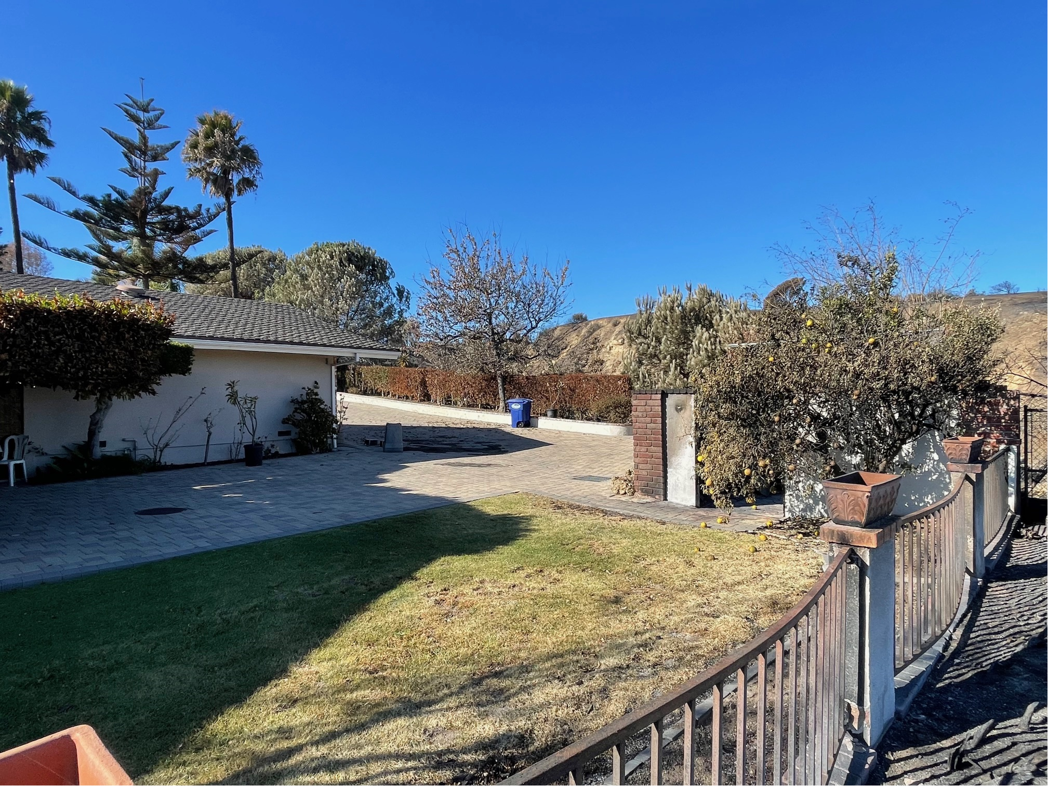
Ornamental landscape - risk

Slide 22
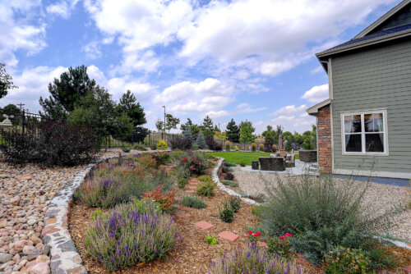
Zone 0 - landscape

Slide 23
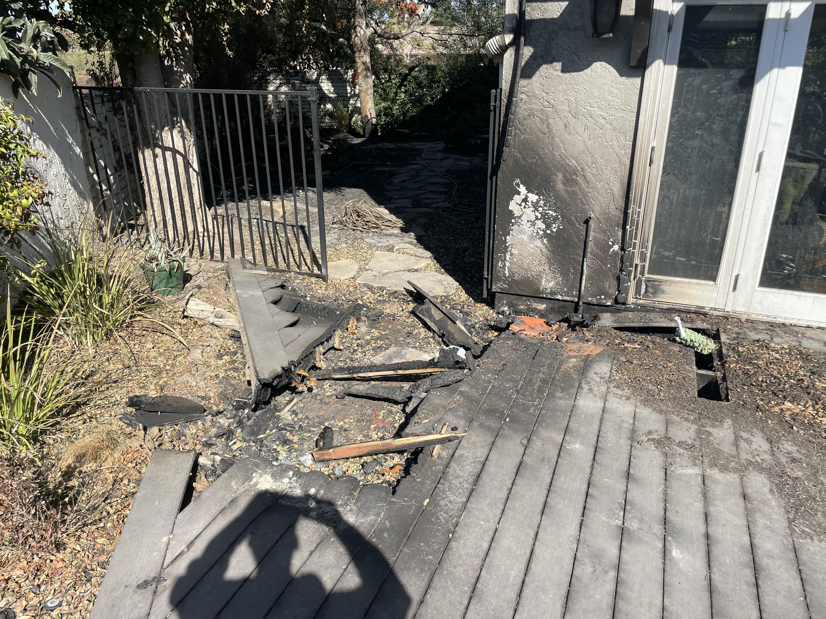
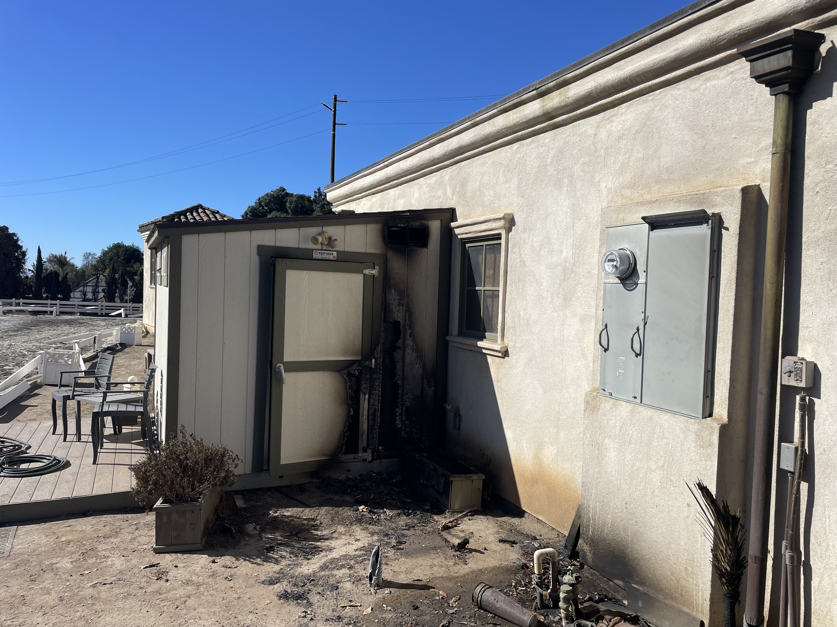
Combustible Materials
Decks Sheds

Slide 24
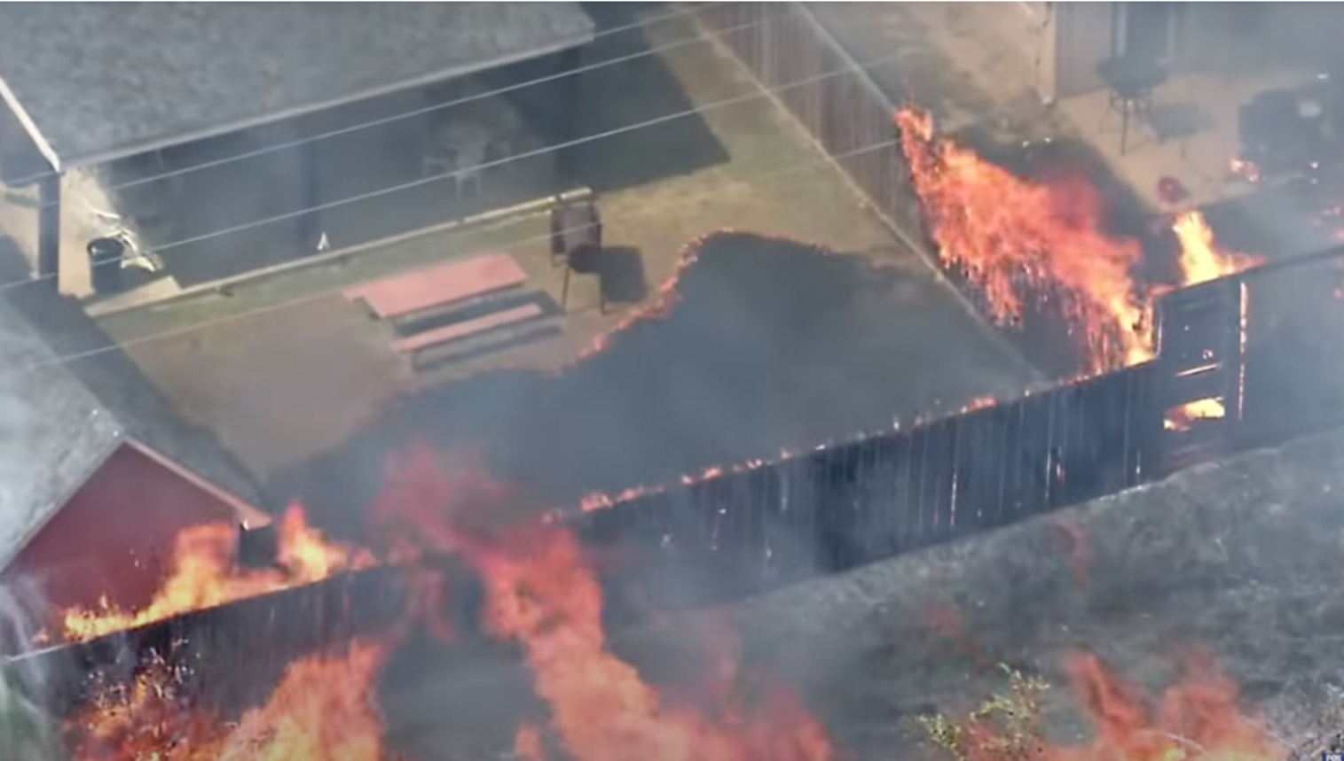
Combustible fencing

Slide 25
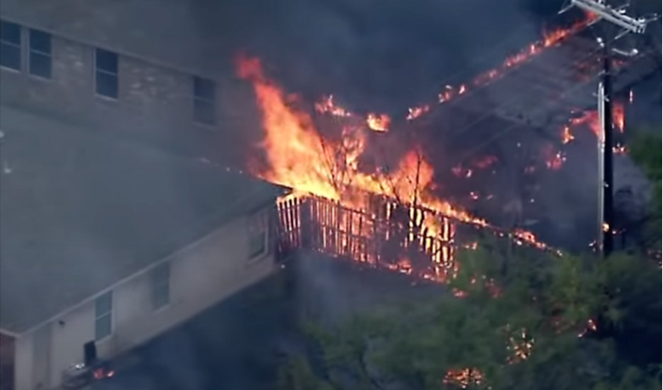
Combustible fencing

Slide 26
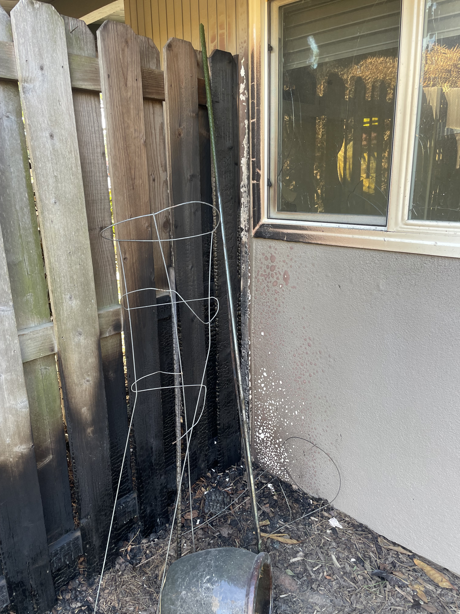
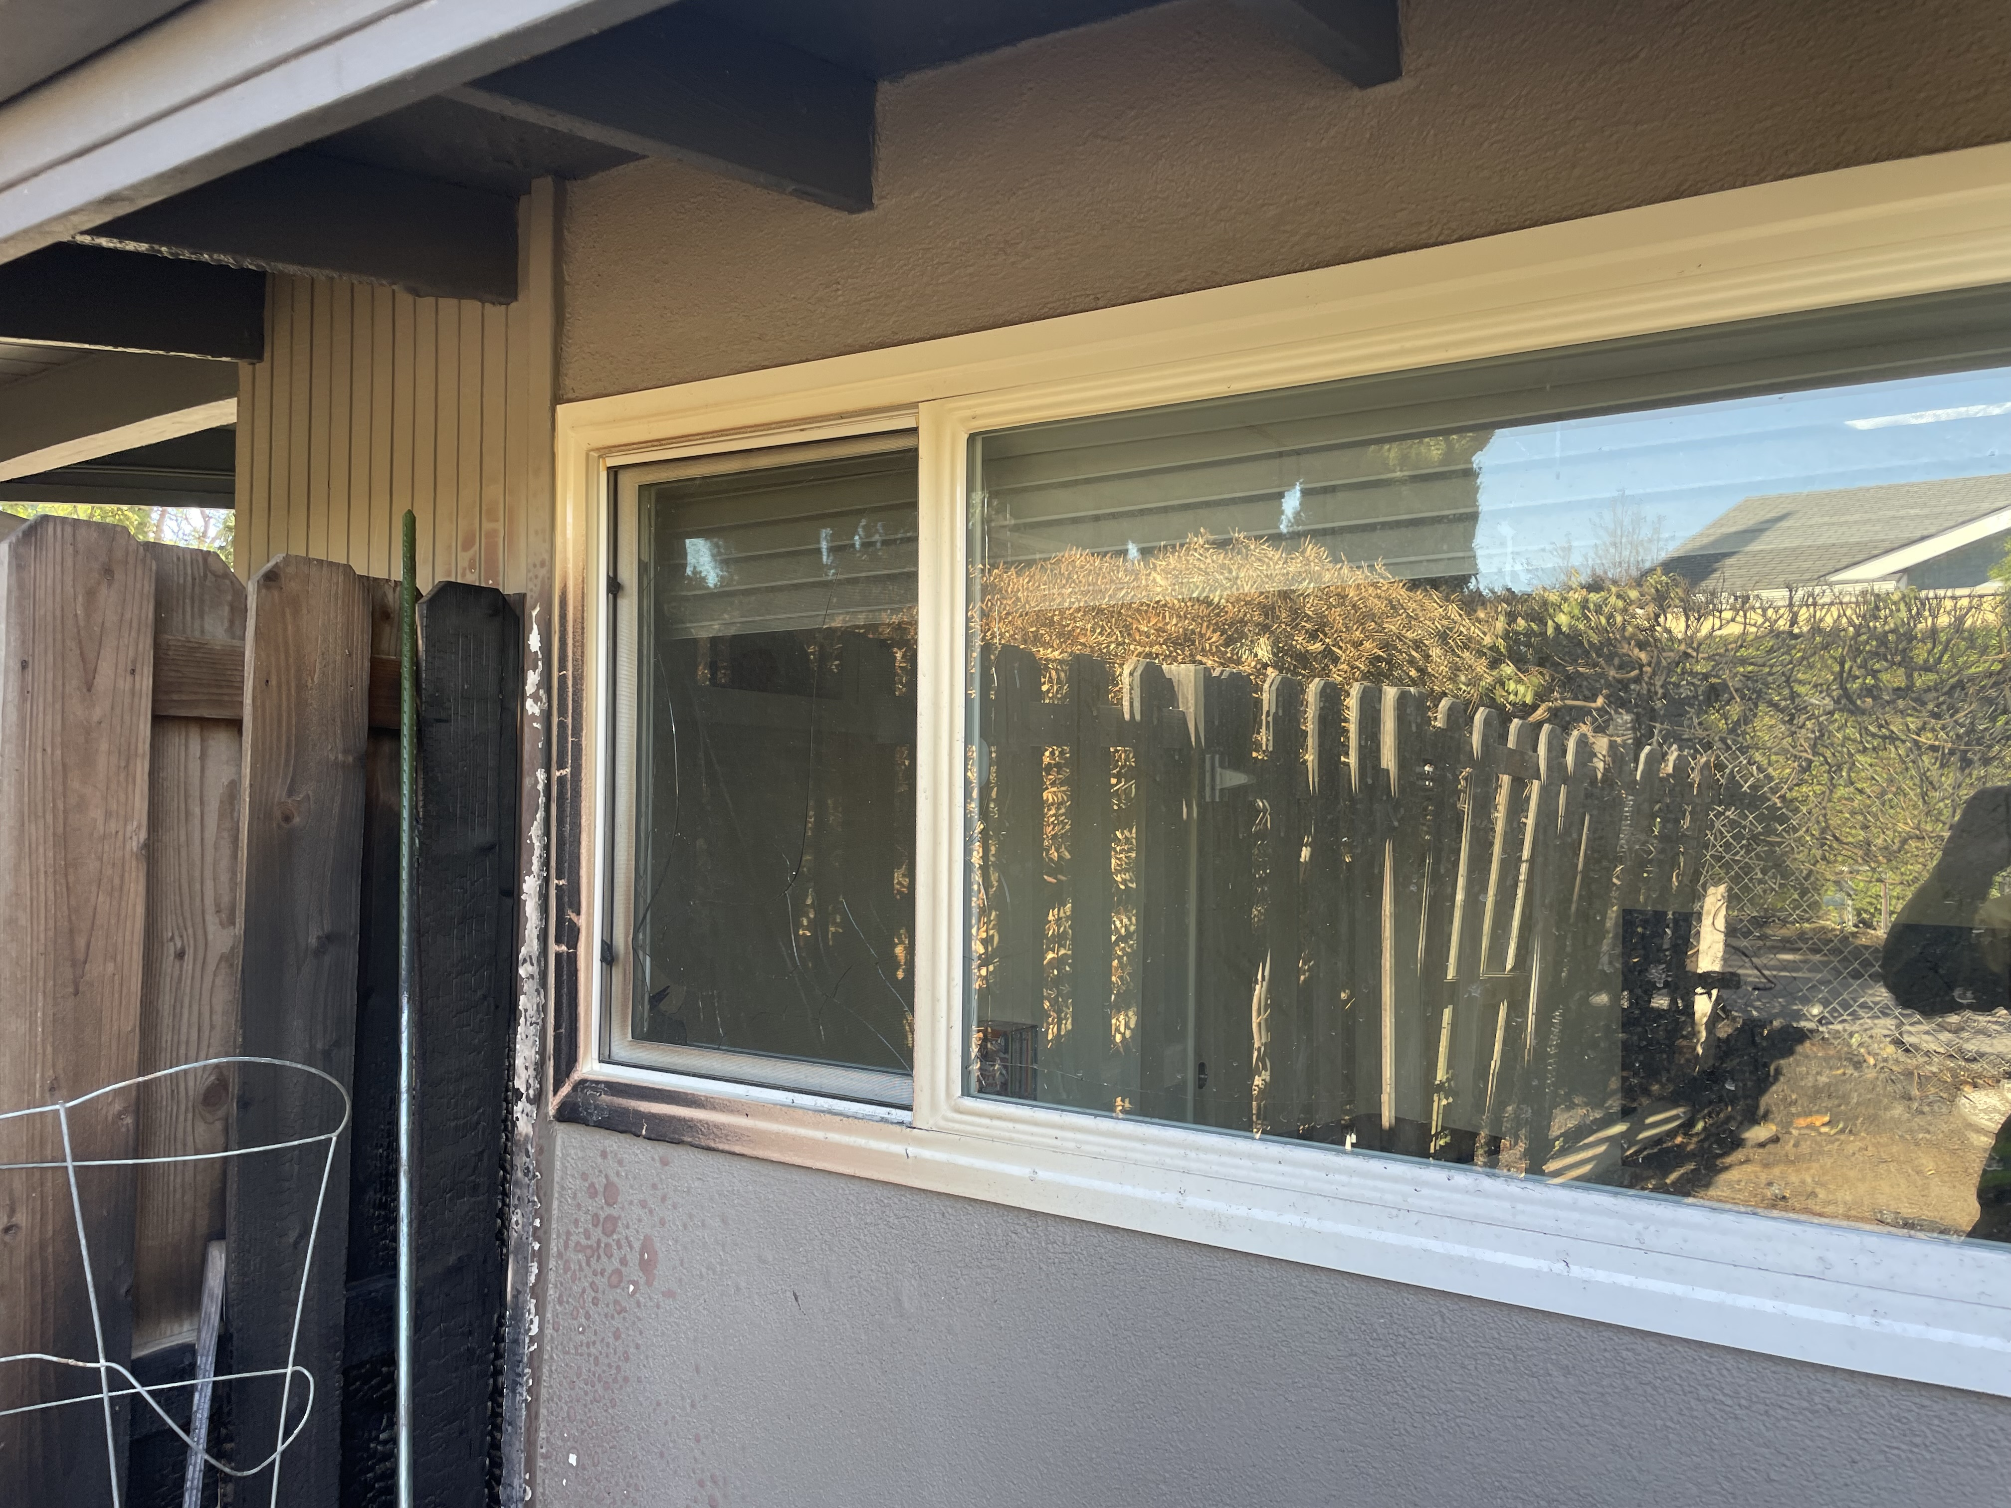
Combustible fencing – 5 ft

Slide 27
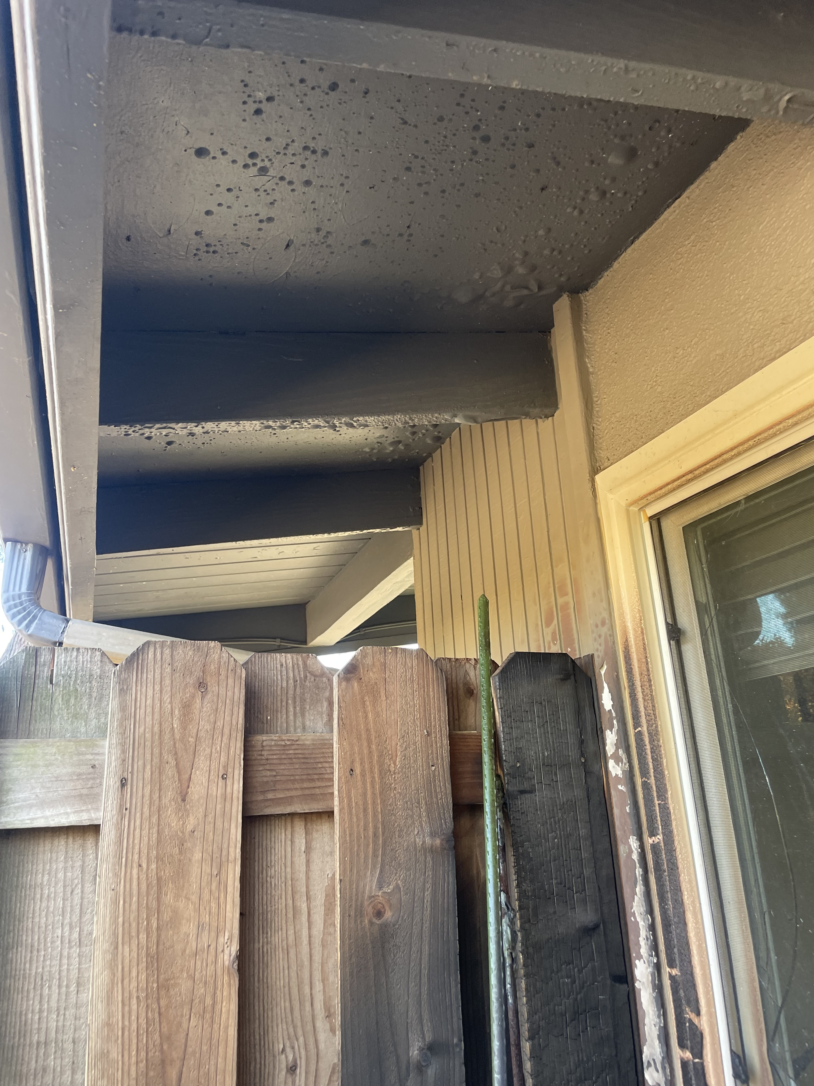
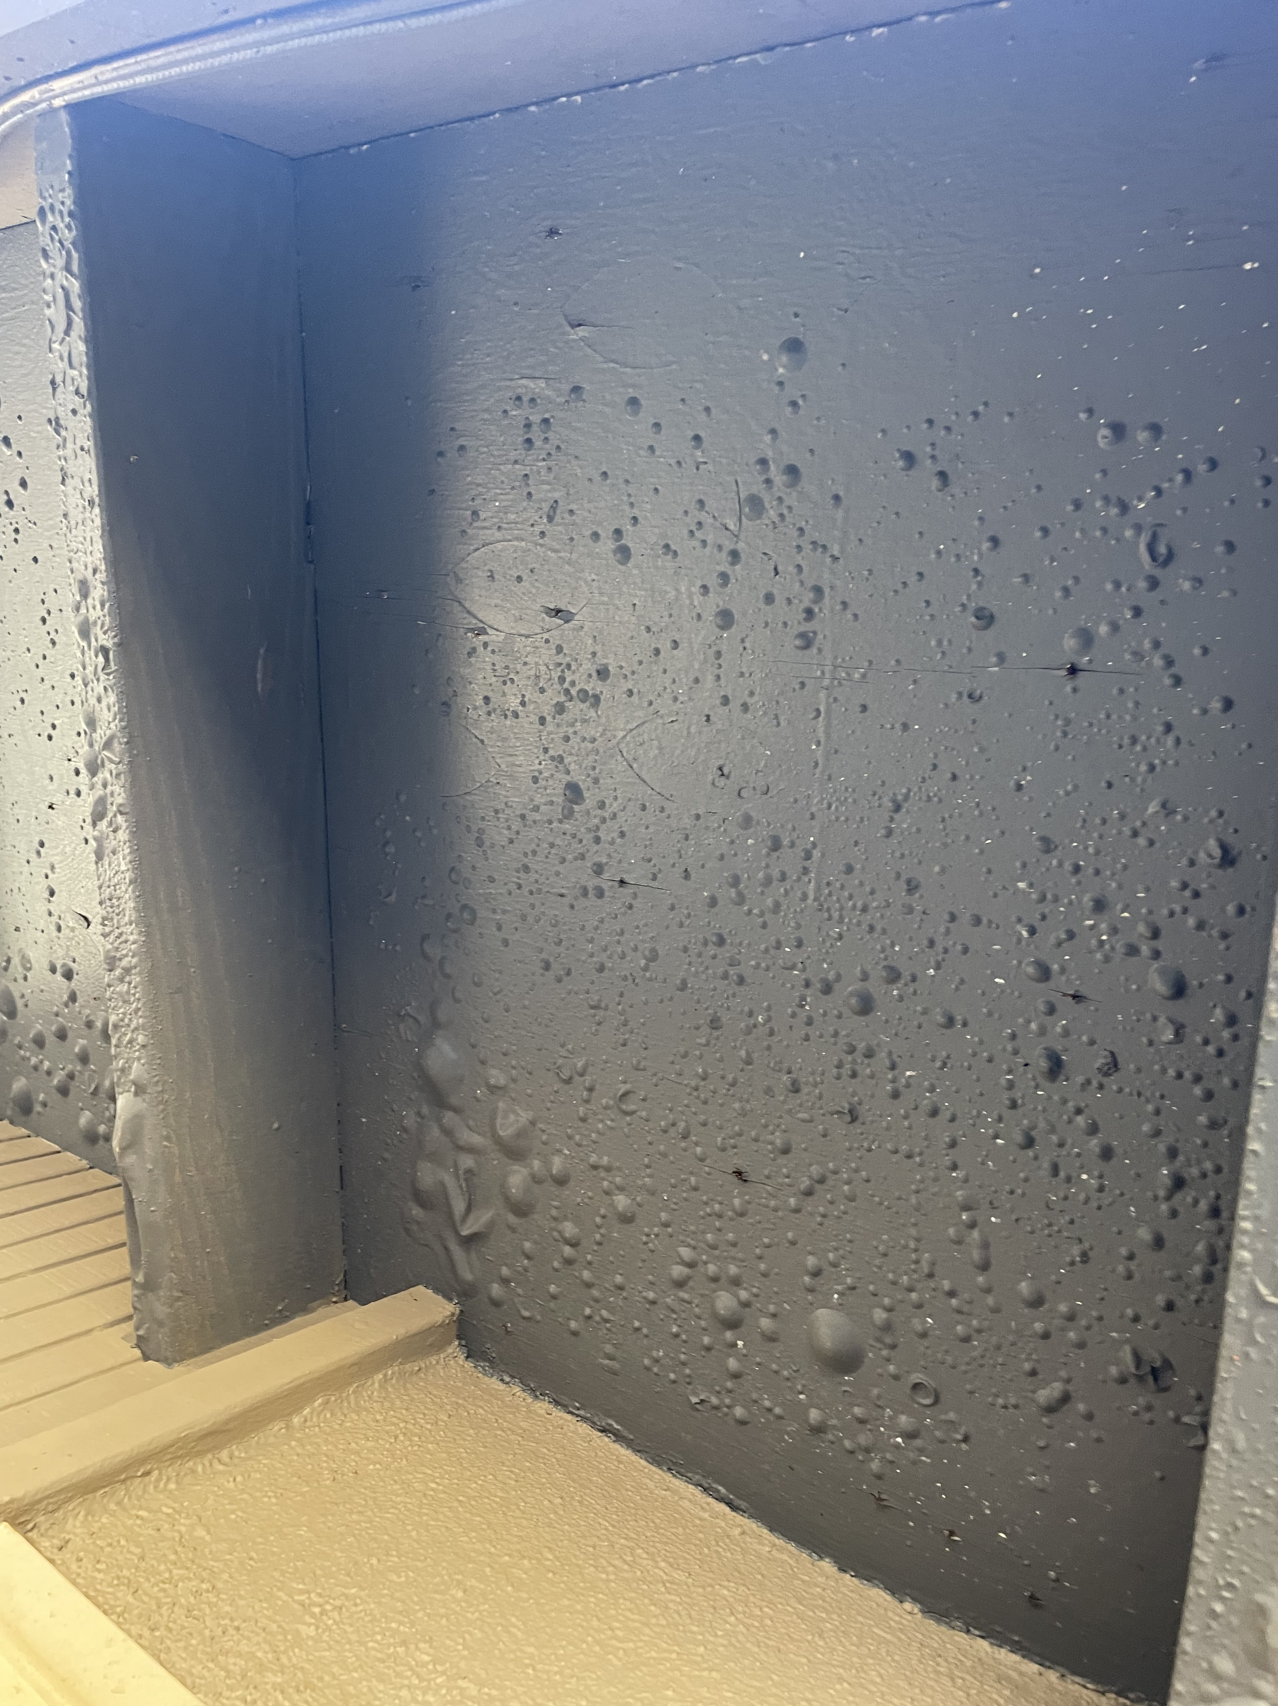
Combustible fencing – 5 ft

Slide 28
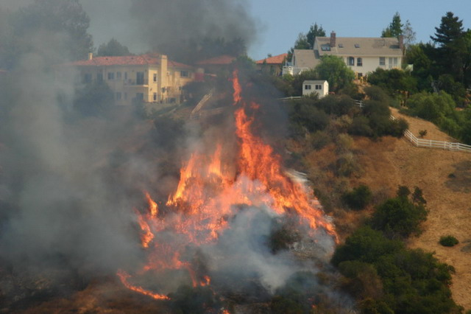
questions?

